Slide 1

Book Recommendation System
BOOK Recommendation System
TEAM MEMBERS-
Arpit Jain - 21UCS031
Aryan Khandelwal - 21UCC027
Ekansh Khandelwal - 21UCC039
Under the guidance
of
Dr. RITU SHARMA

Slide 2

Introduction
Welcome to our presentation on Book Recommendation Systems!
Explore how machine learning algorithms enhance reading experiences.
Learn how data analysis of reading history and ratings drives accurate suggestions.
See how this system benefits both readers and the publishing industry.
Suggests relevant books to readers.
Analyzes user preferences and behavior.
Considers reading history, ratings, and demographic data.

Slide 3

What is a Recommendation System?
1
Personalized Suggestions
2
Enhancing User Experience
A recommendation system is a class of machine learning algorithms that offer relevant and personalized suggestions to users based on their preferences, browsing history, and behavior.
By providing tailored recommendations, these systems enhance the user experience by helping them discover new products, services, or content that aligns with their interests, reducing the time and effort required to find desired items.
3
Building Customer Loyalty
Recommendation systems help organizations create loyal customers and build trust by offering desired products and services, ultimately increasing customer satisfaction and retention.

Slide 4
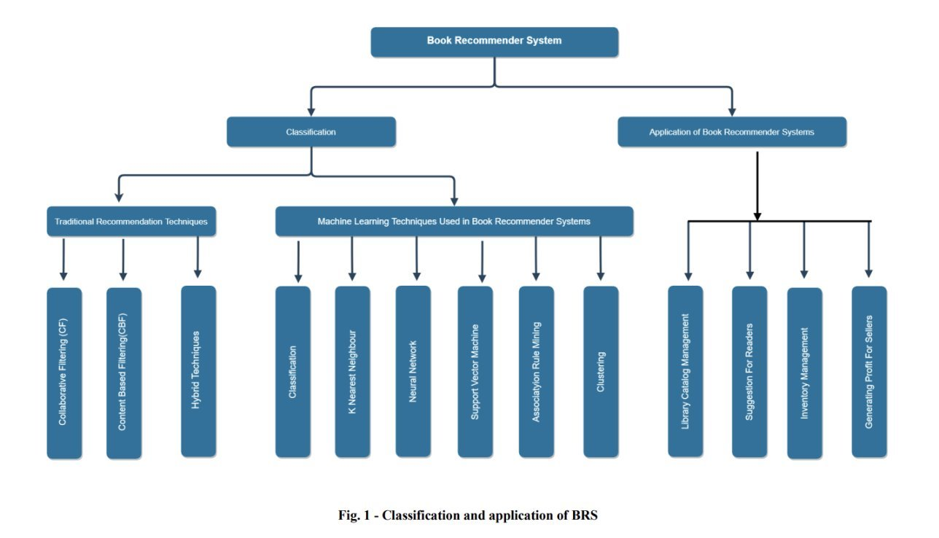
Literature Review

Slide 5
Analysis Of Research Papers
Paper Name | Year of Publishing | Author Name | Technique Used | Advantage | Limitations
1. A Deep Learning Approach for Multi-Criteria Collaborative Filtering in Recommender Systems | 2019 | Nour Nassar, Assef Jafar, Yasser Rahhal | Multi-Criteria Collaborative Filtering | 1. Novel Approach 2.Improved Performance | 1. Lack of Comparison 2. Dataset Specificity 3. Complexity and Scalability
2. Book Recommendation System using Machine Learning | 2015 | Fatima Ijaz | K-NN, and matrix factorization | 1 . Accurate Analysis 2. Scalability and Efficiency | 1. Data sparsity 2. Cold Start problem
3. Personalized Book Recommendation System using Machine Learning Algorithm | 2019 | Dhiman Sarma, Tanni Mittra, and Mohammad Shahadat Hossain | Machine Learning Algorithm | 1. Enhanced Accuracy 2. Book-Centric Recommendations | 1. Neglects Timeliness 2.Inability to Adapt to E-commerce
4. College Library Personalized Recommendation System Based On Hybrid Recommendation Algorithm | 2020 | Yonghong Tiana, Bing Zhenga, Yanfang Wanga, Yue Zhanga , Qi Wua | Hybrid Recommendation Algorithm | 1. Boosted Precision 2. Reduced Data Sparsity Impact | 1. Privacy Concerns 2. Bias in Recommendations 3. Limited Scope of Recommendations

Slide 6
Analysis Of Research Papers
Paper Name | Year of Publishing | Author Name | Technique Used | Advantages | Limitations
1. Enhancing Collaborative Filtering-Based Recommender System Using Sentiment Analysis | 2020 | Ikram Karabila ,Nossayba Darraz | Sentiment Analysis | 1. Sentiment Analysis Integration 2. Collaborative Filtering Enhancement | 1. Sentiment Analysis Challenges 2. Data Quality Issues:
2. Towards the design of user-centric strategy recommendation system for Collaborative human tasks | 2021 | Lakshita Dodeja , Pradyumna Tambwekar | user-centered design | 1. Innovative User Experiment 2. Focus Beyond Traditional Domains | 1. Focus on Perception 2. Generalizability
3. AI based Book Recommender System with Hybrid Approach | 2021 | Mercy Milcah Y. and Moorthi K. | Hybrid Approach | 1 . Hybrid approach 2. Matrix factorization | 1. Data sparsity 2. Cold-start problem
4. Pattern‑based hybrid book recommendation system using semantic relationship. | 2021 | Fikadu Wayesa , Mesfin Leranso , Girma Asefa & Kedir. | semantic relationship. | 1 .Increased Scalability through Clustering 2. Demonstrated Effectiveness with IR Metrics | 1. Data Quality and Complexity 2. Computational Cost 3. Bias in Underlying Data

Slide 7
Problem Formation
"Create a book recommender system that suggests new books to users based on their preferences and past ratings, even for books they haven't rated yet."

Slide 8
Objectives
Objectives
Conduct Exploratory Data Analysis (EDA) on datasets to gain insights into the underlying data structures and distributions.
Implement Popularity and collaborative filtering techniques to analyse user interactions and similarities to generate accurate recommendations.
Incorporate content-based filtering to consider book attributes such as genre, author, and topic to enhance recommendation relevance.
Explore hybrid recommendation approaches combining collaborative and content-based filtering for improved accuracy.
Evaluate the performance of the recommendation system using metrics like precision, recall, and Mean Absolute Error (MAE).

Slide 9



Our Datasets
Books.csv
This file contains information about books, including their ISBN, title, author, year of publication, publisher, and cover image URLs. It serves as the primary source of book metadata for the recommendation system.
Ratings.csv
This file contains user ratings for books. These ratings are crucial for training the recommendation algorithms and understanding user preferences.
Users.csv
This file contains user data, including anonymized user IDs and demographic information (location, age) . This data helps the system personalize recommendations based on user characteristics.
The datasets used in this analysis was obtained from Kaggle.

Slide 10

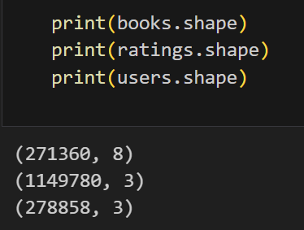
Why this Dataset?
1. Quality of data
2. Size of Dataset
3. Bias and Fairness

Slide 11

Books.head()

Slide 12
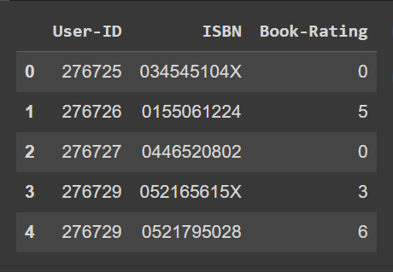

Ratings.head()
Users.head()

Slide 13
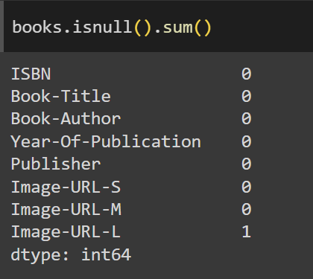
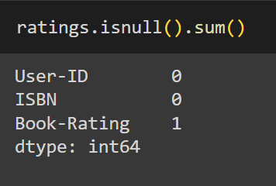
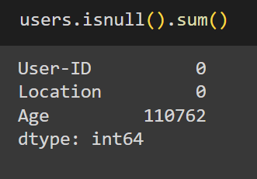
Books.csv
Ratings.csv
Users.csv

Slide 14
Data Pre-Processing
Data Collection
Gather the raw data from various sources such as databases, files
Data Cleaning
Missing/Null Values, Remove Duplicates, Dealing with Outliers
Data Normalization
Transform the data to similar scale.
Dimensionality Reduction
Reducing the dimensions by preserving the most important information

Slide 15

Final Dataset details for Popularity based filtering:
After applying Preprocessing on 3 datasets and merging them our dataset will looke like:

Slide 16
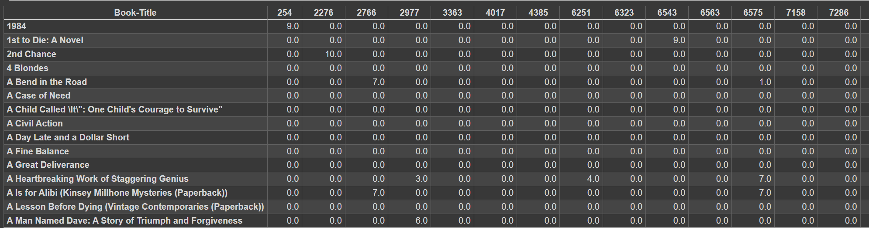
Final Dataset details for Collaborative based filtering:
After applying Preprocessing on 3 datasets and merging them our dataset will looke like and we will be calling this new dataset P:

Slide 17
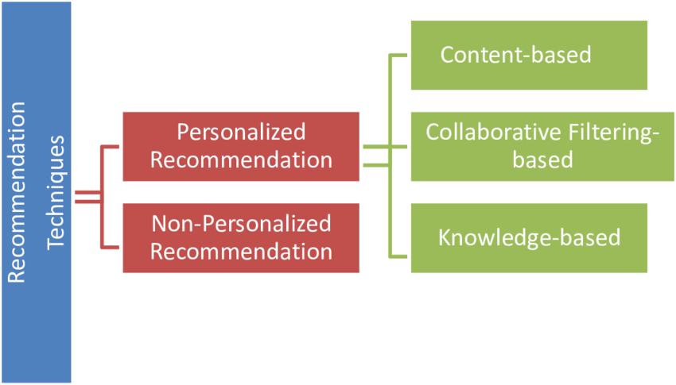
Major Techniques for Book Recommendation Systems
Content-Based Filtering
Collaborative Filtering
Hybrid Filtering
This algorithm recommends books that are similar to previously read by users.
This technique recommends books based on the preferences and behavior of similar readers. It identifies users with similar tastes and suggests books with similar preferences.
This method combines both content-based and collaborative filtering techniques to leverage the strengths of each approach. It provides recommendations based on both item content and user behavior.

Slide 18
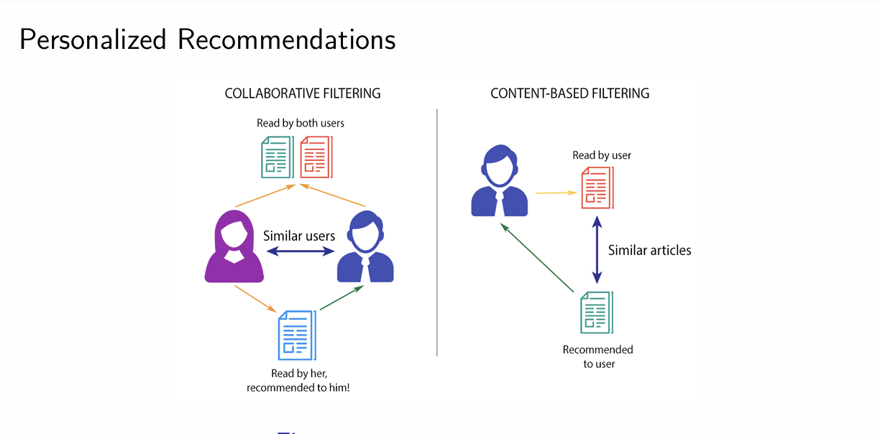

Slide 19

Popularity-Based Recommendations
Approach
Advantages
Popularity-based recommendations suggest items based on their overall popularity or sales data.
Simple to implement and requires less data.
Limitations
The main limitation is that they don't consider individual preferences or tastes. So, they might recommend popular items to everyone, regardless of whether those items match the user's interests or not.

Slide 20

z
Implementing Popularity-Based Book Recommendation System
1
Number of Ratings
Analyzing the number of ratings for each book to determine popularity.
2
Ratings
Considering user ratings to identify books with high engagement.
3
Recommending
Recommending top N books which are sorted on the basis of views and rating

Slide 21

Top 10- Popular Books

Slide 22
Collaborative Filtering
Approach
1
Collaborative filtering recommends items based on the preferences of similar users. It identifies users with common interests and makes recommendations based on their collective tastes.
2
Advantages
Discovers unexpected recommendations, is independent of item metadata, and can adapt to changing user preferences.
Limitations
3
Requires a large user base, suffers from cold start problems, and can be vulnerable to sparsity and data scarcity.

Slide 23



Implementing Collaborative-Based Book Recommendation System
User Preferences
Similar Users
Book Recommendations
Understanding individual reading preferences, genres, and favorite authors.
Identifying users with similar reading habits to create collaborative filters.
Providing personalized books suggestions based on collaborative filtering algorithms.

Slide 24
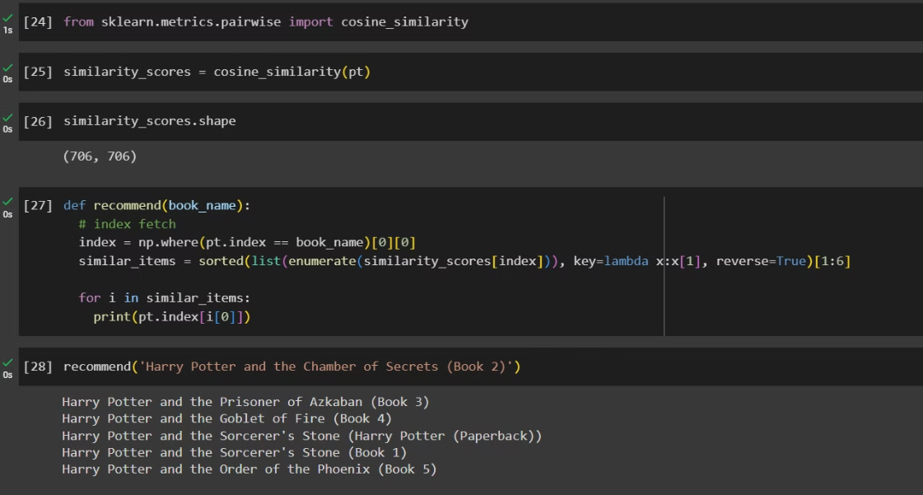
Implementation

Slide 25

Content-Based Filtering
Approach
Advantages
Limitations
Content-based filtering recommends items similar to ones the user has liked in the past. It analyzes item features and the user's preferences to suggest new content.
Provides personalized recommendations, works well for new items, and is independent of other users' preferences.
Requires detailed item metadata, can't recommend items outside the user's past interests, and suffers from overspecialization.

Slide 26
Hybrid Approach
Combining Techniques
Overcoming Limitations
Personalized Recommendations
The hybrid approach combines the strengths of both content-based filtering and collaborative filtering techniques. It leverages the item metadata and content analysis from content-based filtering, while also incorporating user behavior and preference data from collaborative filtering.
By combining these techniques, the hybrid approach can overcome the limitations of each individual method. For example, it can address the cold-start problem (lack of data for new users or items) and provide more diverse and accurate recommendations.
The hybrid approach allows for highly personalized recommendations by considering both the user's preferences and the item's characteristics. It can suggest books that match the user's interests while also exploring new and potentially relevant options based on the preferences of similar users.

Slide 27



Hybrid Model for Book Recommendations
1
Collaborative Filtering
2
Content-Based Filtering
Hybrid Model
3
Integrates both collaborative and content-based techniques for improved recommendations.

Slide 28

Evaluation Metrics for Recommendation Systems
Evaluating the performance of recommendation systems is crucial to ensure they deliver accurate and relevant suggestions to users.
There are various evaluation metrics that can be used to assess the effectiveness of collaborative and content-based book recommendation systems.

Slide 29
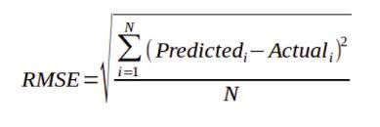

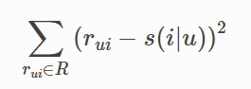
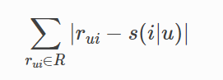
Prediction Accuracy Metrics
for Regression model
Root Mean Squared Error (RMSE)
Mean Absolute Error (MAE)
Measures the average magnitude of errors in a set of predictions, giving a sense of how close predictions are to actual values.
Calculates the average absolute difference between predicted and actual values, providing a more intuitive measure of error.

Slide 30
Top-N Evaluation for Classification Model
Precision @N
1
Measures the fraction of recommended items that are relevant, focusing on the top-N recommendations.
2
Recall @N
Calculates the fraction of relevant items that are included in the top-N recommendations.
F1-Score @N
3
Combines precision and recall into a single metric, providing a balanced evaluation of the recommendation system.

Slide 31
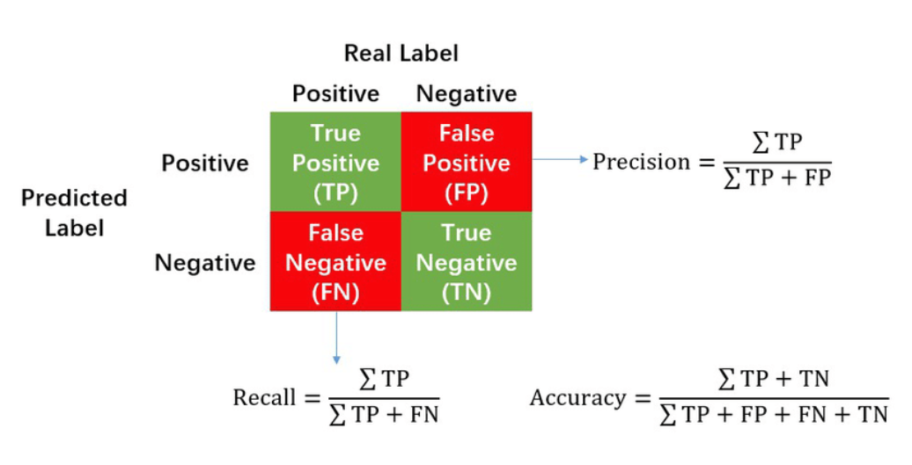
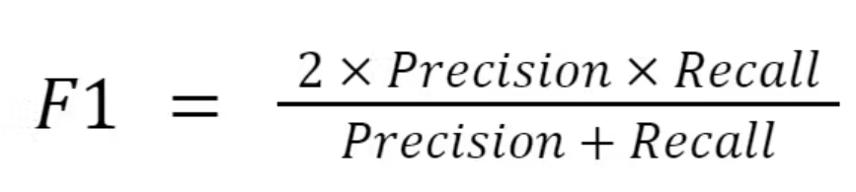
Classification Metrics

Slide 32

Work to be done in next semester:
Hybrid Approach:
Implementing a book recommendation system that will utilize a hybrid approach, which combines multiple recommendation techniques to provide more accurate and diverse book recommendations.
Evaluation and Improvement:
We will continuously evaluate the effectiveness of the hybrid recommendation system through user feedback and performance metrics, making iterative improvements to enhance its recommendation capabilities over time.

Slide 33
References:
1. https://www.sciencedirect.com/science/article/pii/S0950705119302862
2. https://www.sciencedirect.com/science/article/pii/S0957417416305309
3. https://www.semanticscholar.org/paper/Research-on-Personalized-Book-Recommendation-Model-Qi-Liu/5e24c7596dfca429be523e449a4aefc26f09c1bc
4. https://www.sciencedirect.com/science/article/pii/S0167923615000214
5. https://www.kaggle.com/datasets/arashnic/book-recommendation-dataset?select=Ratings.csv
6. https://www.youtube.com/watch?v=1YoD0fg3_EM

